Slide 1

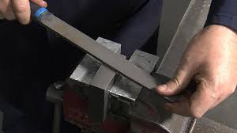
Noida Institute of Engineering & Technology, Greater Noida
FITTING SHOP

Slide 2
FITTING SHOP
Fitting is the process of assembling various parts manufactured in the machine shop
Tools used in Fitting shop 1. Holding tools
Cutting tools
Striking tools
Marking and measuring tools

Slide 3
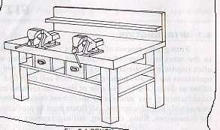
Holding tools-Work bench

Slide 4
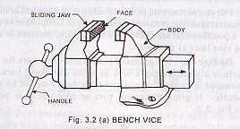
BENCH VICE

Slide 5
Measuring Tools
The most commonly used measuring tools are described below
Steel rule
vernier caliper
Micrometer

Slide 6

Steel rule

Slide 7
Marking Tools
Marking is the process of layout of sizes on work piece. The following tools are used in marking out operations.
1. Scriber
3. Jenny caliper
5. Angle plate
7. Punch
9. Surface plate
2. divider
4. scribing block
6. V-block
8. Try square
10. Straight edge

Slide 8
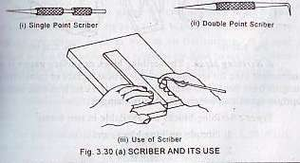
Scriber

Slide 9
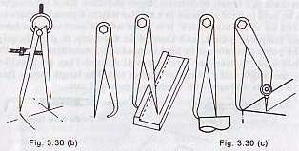
Divider & caliper

Slide 10
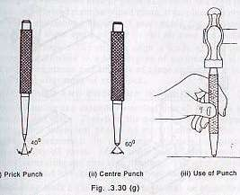
Punch

Slide 11
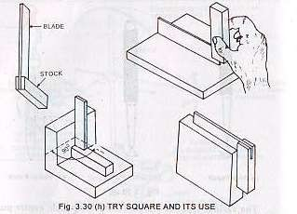
Try square

Slide 12
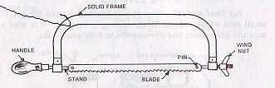
Cutting tool-Solid frame Hack Saw

Slide 13
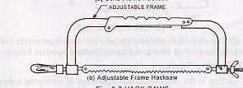
Adjustable frame Hack saw

Slide 14

HACK SAW BLADE

Slide 15
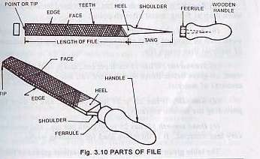
Planing tool- File

Slide 16
Specifications of File
Files are specified according to their
Length
Shape
Teeth pattern
Grade
Ex. 200mm,half round, single cut bastard file

Slide 17
Length of file
Length is measured from heel to point
Files are available from 100mm to 450mm
Common sizes are 100mm, 150mm, 200mm, 250mm, and 300mm.

Slide 18
Grade
Depending on fineness and or pitch of teeth, they are graded as
(a)Rough---8 teeth per cm, rough work (b)Bastard –12 teeth per cm,cuts smaller
amounts than Rough file
(c) Second cut– 16 teeth per cm, better finish than Bastard
smooth– 20 to 24 teeth per cm
Dead smooth– 25 to 40 teeth per cm

Slide 19
Teeth pattern of File
Files are classified as
(a) Single cut files, and
Angle from 45⁰ to 60⁰ from edge
(a) double cut files
70⁰ to 80⁰ from opposite side

Slide 20


Slide 21
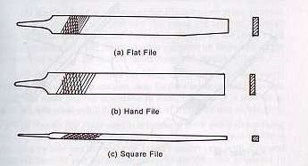
Types of files

Slide 22
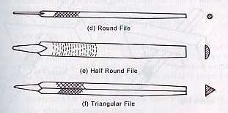
TYPES OF FILES

Slide 23
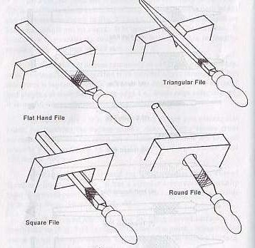

Slide 24
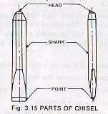
Cutting tool- CHISELS
Chisels are made from high carbon steel or chrome –vanadium steel
It consists following parts
1.Head 2.Body or shank 3.Point or cutting edge

Slide 25
Types of chisels
The most commonly used chisels are
Flat chisel
Cross cut chisel
Half-round chisel
Diamond point chisel
Side chisel

Slide 26


Slide 27


Slide 28
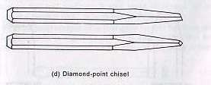

Slide 29
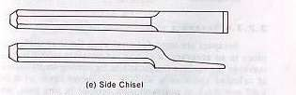

Slide 30
DRILLS
Drills are used to make circular holes These are made up of high-speed steel,
chromium steel and carbon tool steel
It has the following parts
Body
Neck
Shank
Tang

Slide 31
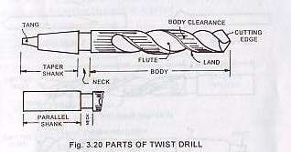

Slide 32
Types of Drills
The following types of drills are more commonly used
Flat drill
Straight fluted drill
Twist drill

Slide 33
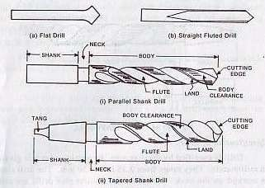

Slide 34

Reamer
After drilling a hole, Reamer is used to finish the drilled hole.
It consists of Body and Shank

Slide 35
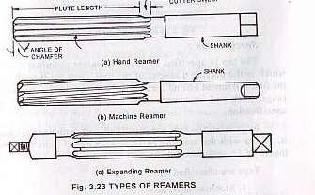

Slide 36

Taps
Taps are used to make internal threads in drilled holes

Slide 37
Types of Taps
Taps are available in following three types
Taper or first tap (rough)
Plug or second tap(semi-finish tap)
Bottoming tap (finish tap)

Slide 38
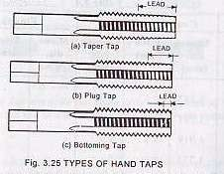

Slide 39
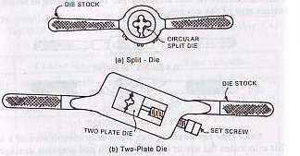

Slide 40
Striking Tools
These are used for striking purposes like punching, chipping, marking, bending, straightening and riveting
Hammer is basic striking tool Parts of hammer
Peen
Face
Eye hole
Handle
head

Slide 41
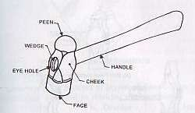

Slide 42
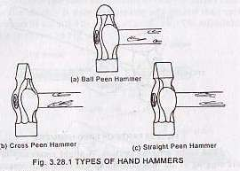

Slide 43
1.WORK BENCH- The work bench is a strong, heavy and rigid table made up of hard wood.
2. BENCH VICE-It is firmly fixed to the bench with the help of nuts and bolts. It consists of a cast Iron body and cast iron jaws. Two jaw plates are fitted on both the jaws. The holding surface of the jaw plates is knurled in order to increase the gipping. Jaw plates are made up of carbon steel and are wear resistant. One jaw is fixed to the body and the second slides on a square threaded screw with the help of a handle.
3. STEEL SCALE- These are made up of stainless steel and are available in many sizes ranging from 1/2 ft. to 2 ft. These are marked in inches or millimetres.
4. VERNIER CALIPER- It is used for measuring the outer dimensions of round, flat, square components and also the inner size of the holes and bore.
5. SCRIBER-Scriber is made up of high carbon steel and is hardened from the front edge.
6. PUNCHES- Punches are used for marking purposes. Dot punches are used for marking dotted line and centre punch is used to mark the centre of hole before drilling. Punches are made up of high carbon steel or high speed steels. One end is sharpened. Hammering is done on the second end while working. For dot punch, angle of the punching end is 60 degree while in centre punch; angle of punching end is 90 degree.
7. TRY SQUARE- It is used for checking squareness of two surfaces. It consists of a blade made up of steel, which is attached to a base at 90 degree. The base is made up of cast iron or steel. It is also used to mark the right angles and measuring straightness of surfaces.

Slide 44
HACKSAW-Hacksaw is used for cutting of rods, bars, pipes, flats etc. It consists of a frame, which is made from mild steel. The blade is placed inside the frame and is tightened with the help of a flange nut. The blade is made up of high carbon steel or high speed steel.
FILES- Files are multi points cutting tools. It is used to remove the material by rubbing it on the metals. Files are available in a number of sizes, shapes and degree of coarseness. In single cut files the teeth are cut in parallel rows at an angle of 60 degree to the face. Another row of teeth is added in opposite direction in case of double cut files. Material removal is more in case of double cut files.
TWIST DRILL-Twist drills are used for making holes. These are made of high speed steel. Both straight and taper shank twist drills are used with machines. Hole making operation is drilling.
TAPS- A tap is a hardened steel tool, used for cutting internal threads after drilling a hole. Hand taps are usually supplied in sets of three for each diameter and thread pitch. Internal thread making operation is known as tapping.
HAMMERS-Hammers are named depending on their shape and material and specified by their weight. A ball peen hammer has a flat face which is used for general work and the ball end particularly used for revetting. They weigh from 200 gm to 1.5 kg. The hammer consists of a hardened and tempered steel head varying in mass from 0.1 kg to about 1 kg, firmly fixed on a tough wooden handle. The flat striking surface is known as the face, and the opposite end is called the peen. The most commonly used is the ball-peen, which has a hemispherical end and is used for rivelting over the ends of pins and rivets.

Slide 45
http://home.iitk.ac.in/~vkjain/TA202-Hand-Tools.pdf

Slide 46
THANK YOU

